Slide 1
Game Engines
GAT240

Slide 2
Projects
Usually stored as a collection of files
May have a root project file
Can be stored all in one but not as common
Resources / Assets are stored a different files

Slide 3
The Viewport
Used to preview the scene, select and manipulate objects, use tools
Preview the scene with lighting effects or without

Slide 4
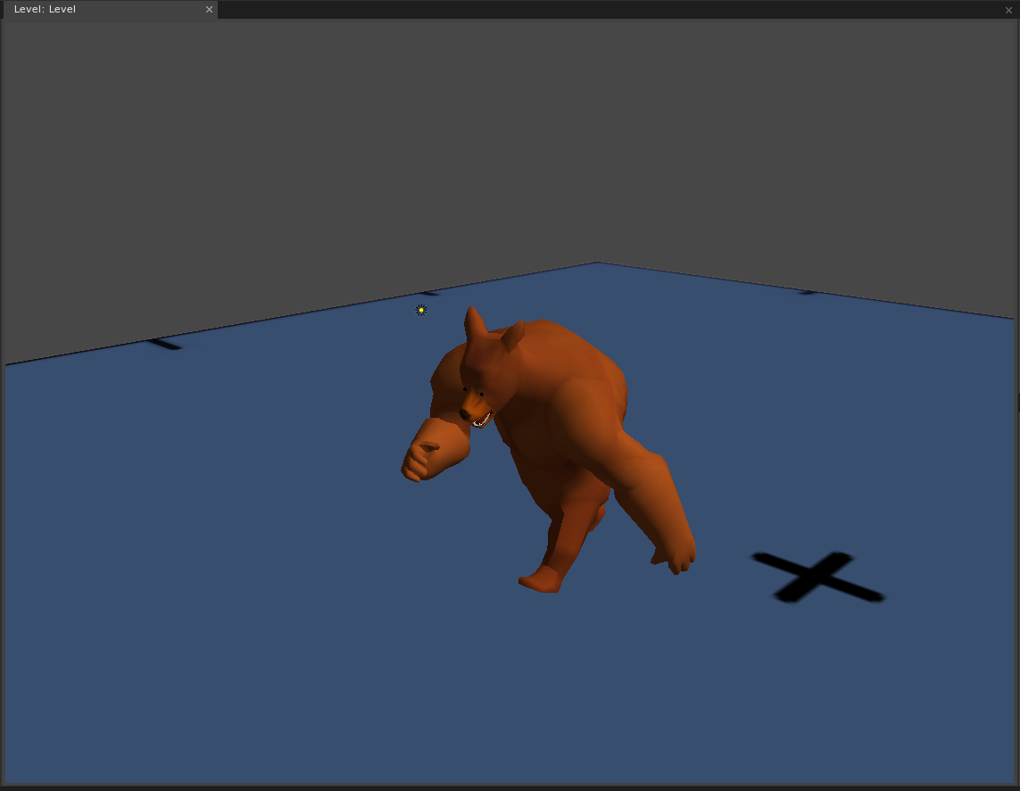
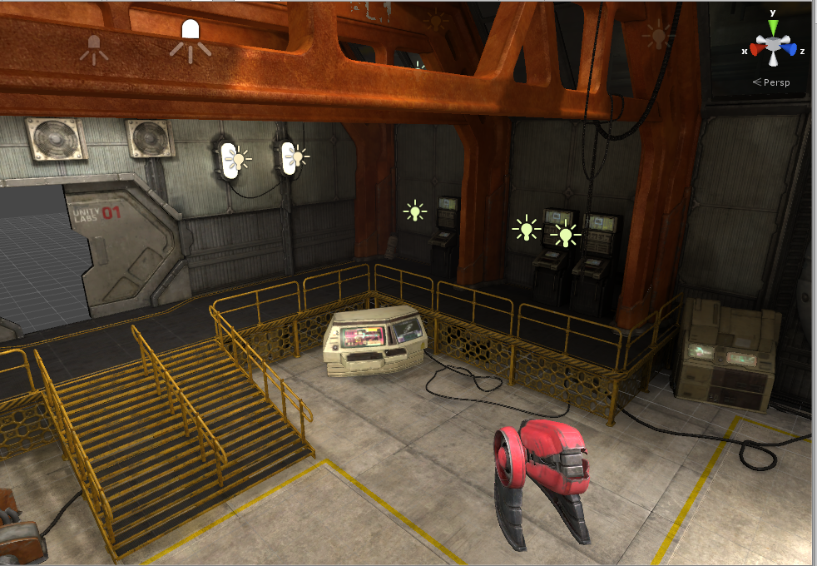
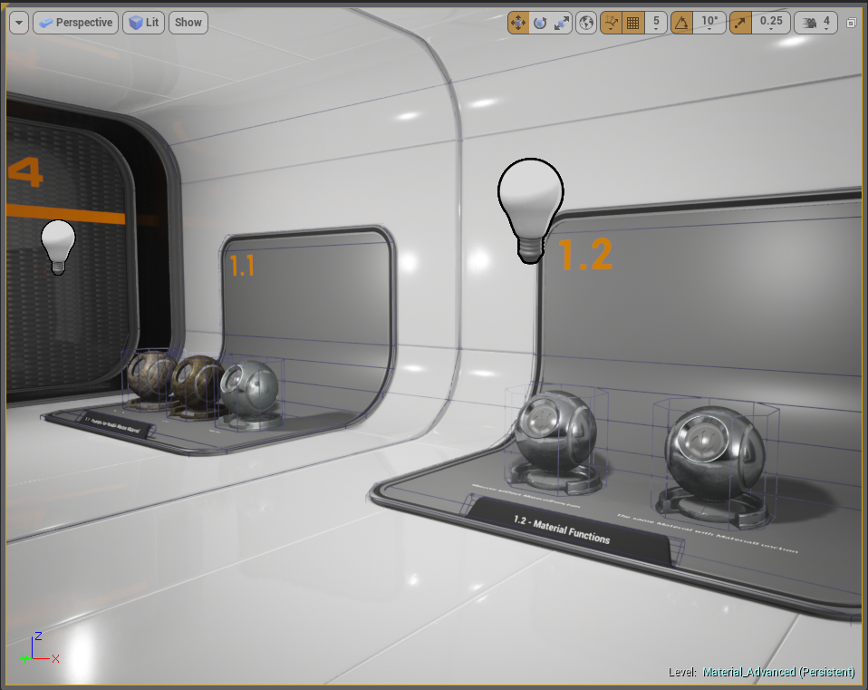

Slide 5
Terms
Game Objects
A piece of interactive logical content
Level / Scene
A collection of game objects

Slide 6
Tools
Tools are what happens when you click in the viewport
Used for painting, editing terrain, tile editing, etc
May have their own settings etc
“What happens when you click”

Slide 7
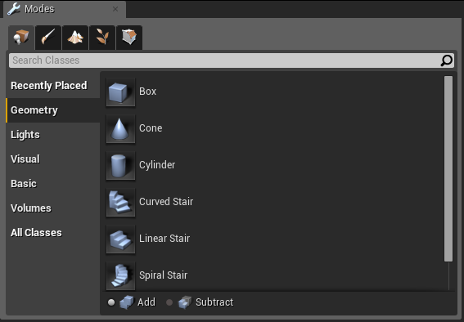
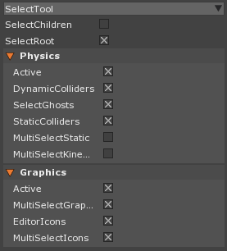

Slide 8
Library / Project
Show all stored assets / resources in the project
Resources are objects like texture, meshes, levels, etc
Provides resource searching and organization
Tags vs Folders

Slide 9
Terms
Resource / Asset
A object that stores shared state or expensive data

Slide 10
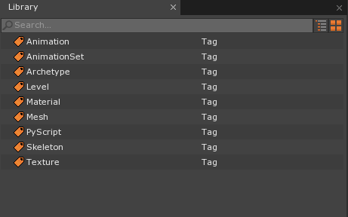
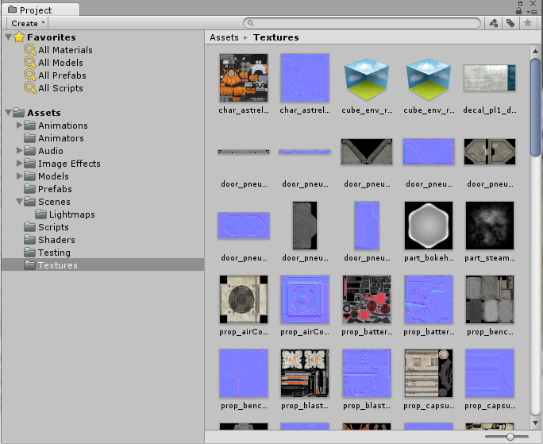
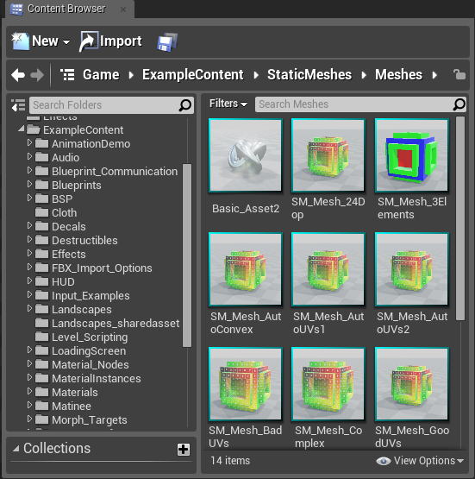

Slide 11
Properties
Property Grid, Details, Inspector
Used to change properties on selected objects
Special Editors for Colors and other values
Basic Editor for almost any object

Slide 12
Terms
Property
Name Value pair on an object
Value Property
Reference Property (refers to another object)

Slide 13
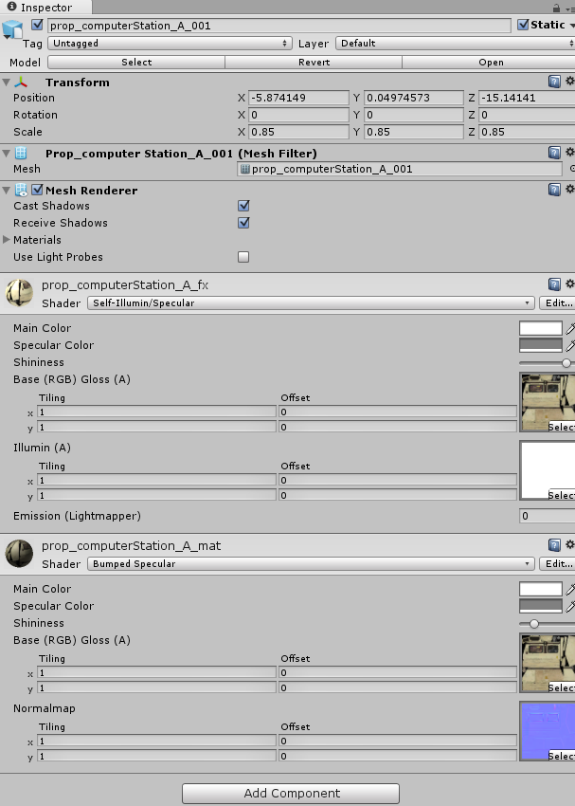
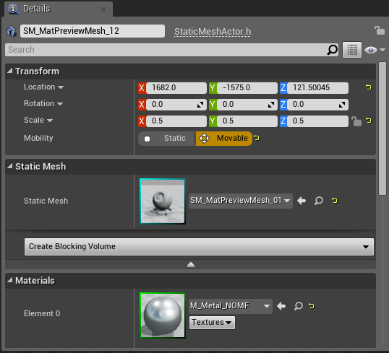
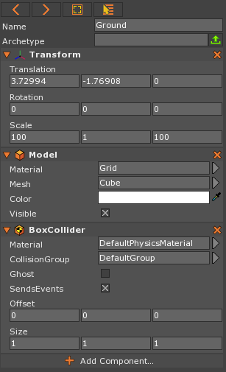

Slide 14
Objects
Show transformation hierarchy of all objects in the level / scene

Slide 15
Terms
Hierarchy
Display of objects in a parent child relationships

Slide 16
